Slide 1

UNIVERSITI TEKNOLOGI MALAYSIA
Breast Cancer Classification Through Integrated Omics Variations Using Stacked Denoising Autoencoder (SDAE) and Variational Autoencoder (VAE) Algorithms
Group 9
Felicia Chin Hui Fen A20EC0037
Phang Cheng Yi A20EC0131
Goh Yitian A20EC0038
Mohd Firdaus Bin Zamri A20EC0080

Slide 2
01
Introduction
Table of Contents
02
Literature Review
03
Methodology
04
Results and Discussion
05
Conclusion

Slide 3
Breast Cancer
characterized by the uncontrolled growth of abnormal cells in the breast, leading to the formation of tumors.
highly heterogeneous disease, consisting of various biological subtypes.
Each subtype has unique clinical presentations, pathological characteristics, and molecular signatures, which influence their prognosis and treatment options.
Therefore, accurately classifying breast cancer subtypes is crucial for precise treatment and prognosis prediction.
5 intrinsic subtypes: luminal A, luminal B, HER2 overexpression, basal-like, and normal-like cancer.

Slide 4
Omics Data
Copy Number Variation: Altered gene dosage due to duplications or deletion.
mRNA Expression: Reflects gene expression levels.
DNA Methylation: Epigenetic modification affecting gene expression.
microRNA (miRNA) Expression: Small non-coding RNAs regulating gene expression.
multi-omics: Concatenate all the four above omics into one.

Slide 5
Problem Statement
One of the methods to perform Multi-omics analysis in order to classify cancer is using Stacked Denoising Autoencoder (SDAE).
high computational costs and time consumption might result from computing Stacked Denoising Autoencoder (SDAE) with millions of parameters in a single training process.
the lack of an appropriate classification technique to incorporate reliable and instructive genomic data results in significant bias.

Slide 6
Objectives
To classify breast cancer based on integration of omics variation data using SDAE and VAE algorithms.
To analyze the performance of SDAE and VAE in omics data analysis.
To evaluate the classification accuracy obtained from SDAE and VAE by implementing integrated variation of omics data.

Slide 7
Research Questions
Are the Variational Autoencoders (VAE) can outperform Stacked Denoising Autoencoders (SDAE) in integrated omics data for breast cancer classification?
What techniques can be used for feature selection and dimensionality reduction to decrease the number of parameters in SDAE and VAE?
Does integrating multiple types of omics data result in better accuracy and classification performance compared to analyzing single omics data alone?
Do SDAE and VAE take into account the relationships between different types of omics data?

Slide 8
Literature Review
Author(s) & Year | Title | Methodology | Result
(Huang et al., 2024) | Classifying breast cancer subtypes on multi‑omics data via sparse canonical correlation analysis and deep learning | Differential Sparse Canonical Correlation Analysis Network (DSCCN) Logistic regression model/multinomial model with Elastic Net (EN) regularization Random Forest (RF) DeepMo Sparse Multi-View Partial Least Square DIABLO | 83.45% of accuracy for 5 subtypes. 77.55% of accuracy for 10 subtypes.
(Ren et al., 2024) | Classifying breast cancer using multi-view graph neural network based on multi-omics data | Multi-view Graph Neural Network (MVGNN) | MVGNN model with all three types of omics data perform better than those using two or just one type of omics data.
(Choi and Chae, 2023) | moBRCA‑net: a breast cancer subtype classification framework based on multi‑omics attention neural networks | proposed moBRCA-net Support vector machine (SVM) Random Forest (RF) Logistic Regression (LR) Naive Bayes | moBRCA-net outperformed other machine learning with an average accuracy of 0.891.
(El-Nabawy et al., 2021) | A Cascade Deep Forest Model for Breast Cancer Subtype Classification Using Multi-Omics Data | Cascade Deep Forest model | 83.45% of accuracy for 5 subtypes. 77.55% of accuracy for 10 subtypes.

Slide 9
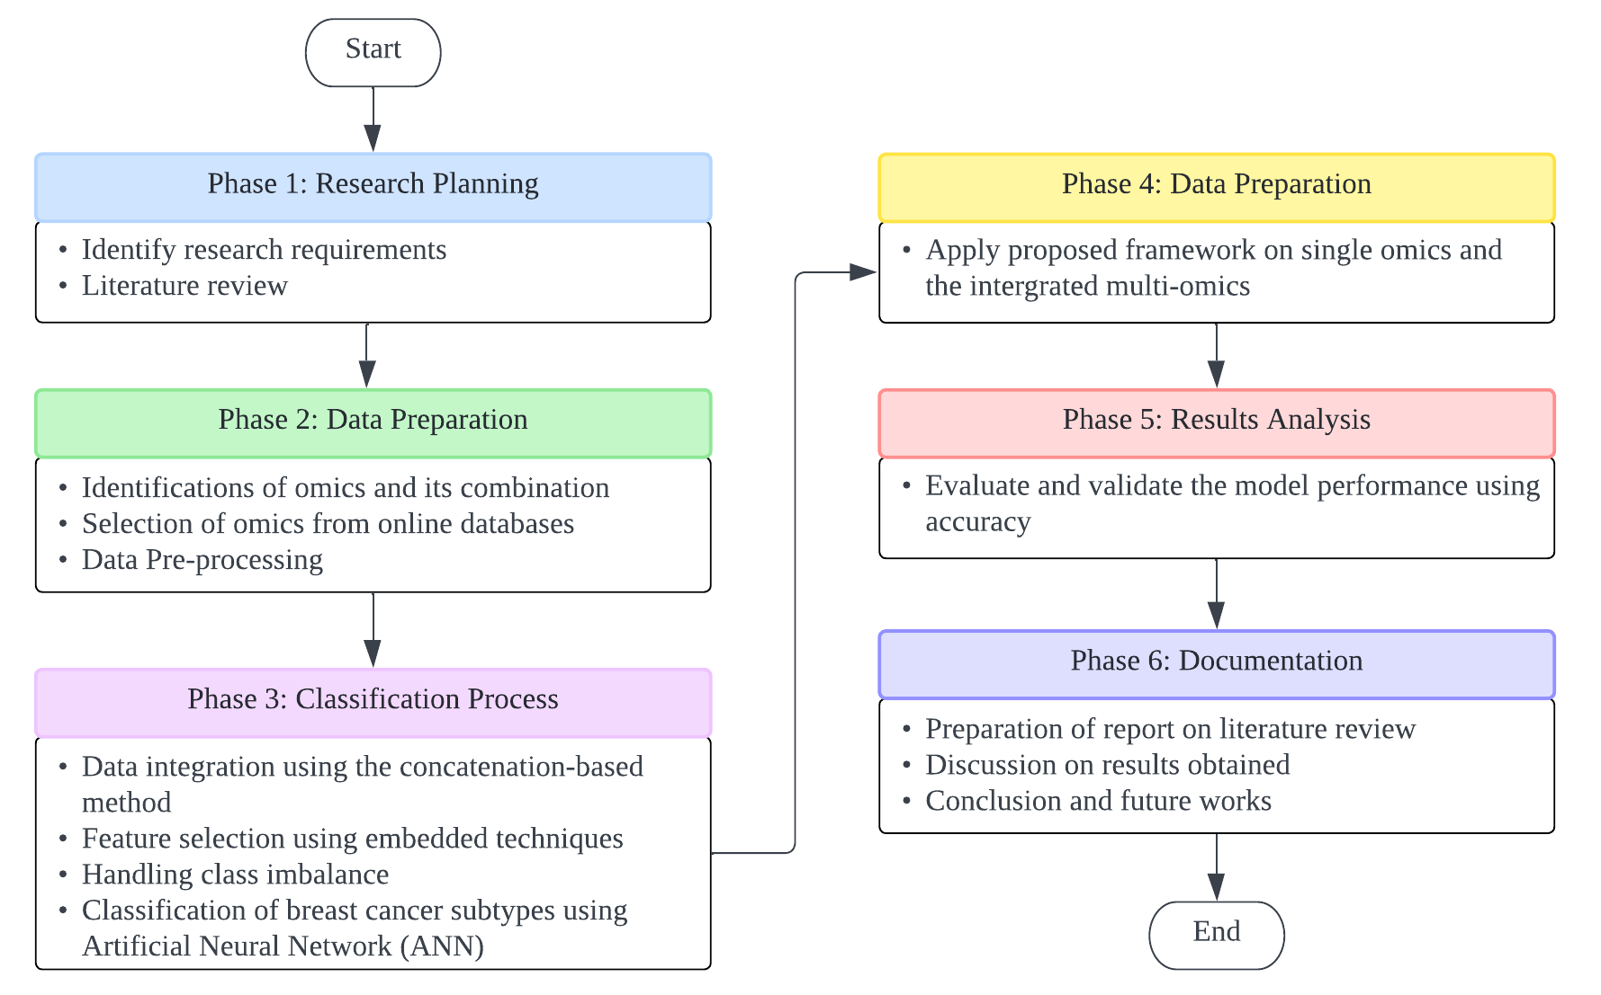
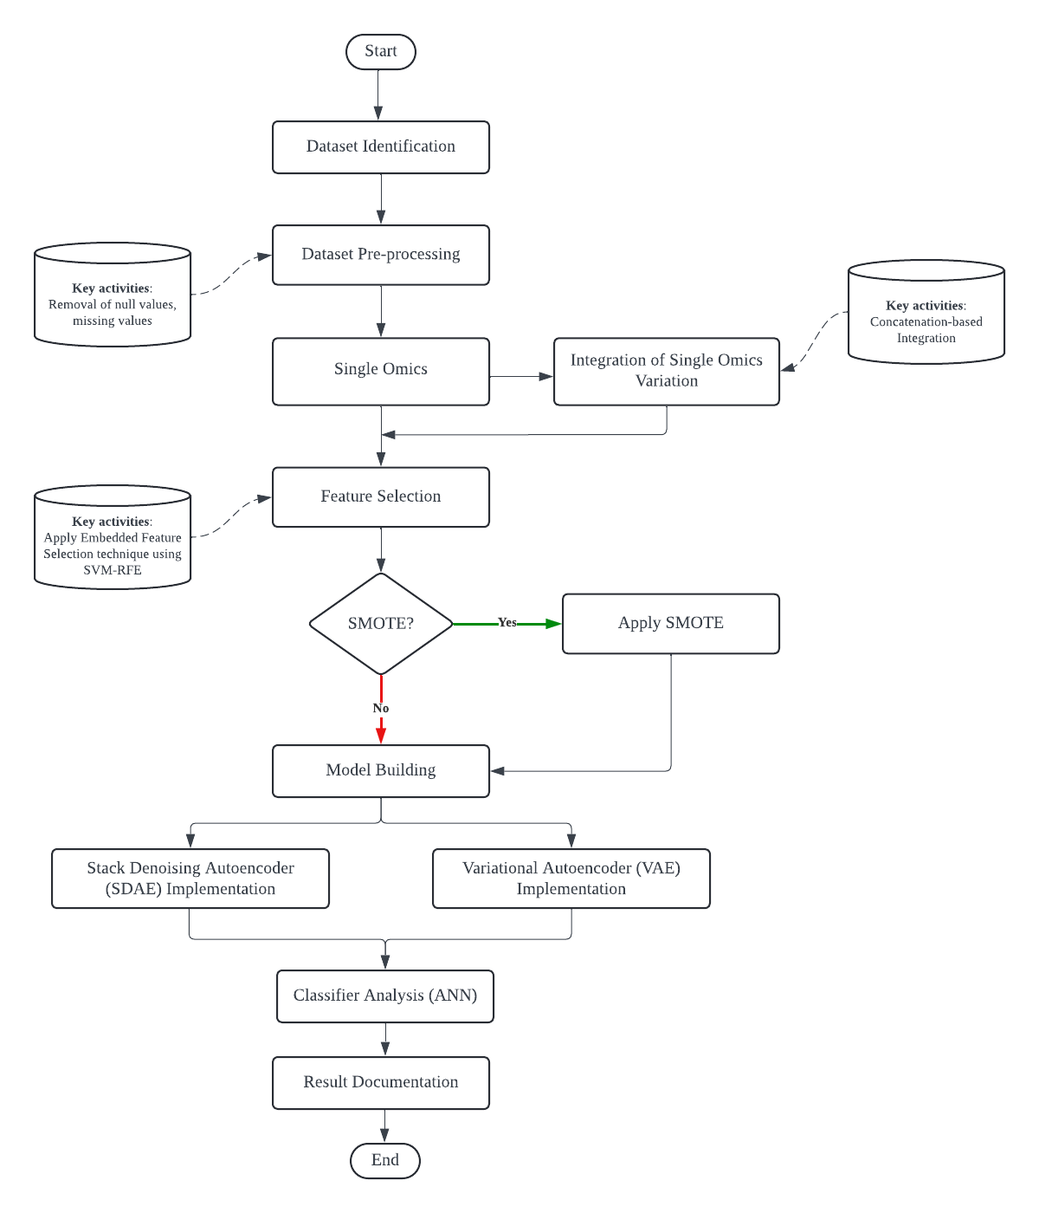
Methodology
Research Operational Framework
Experimental Design

Slide 10
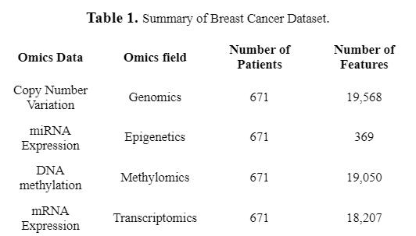
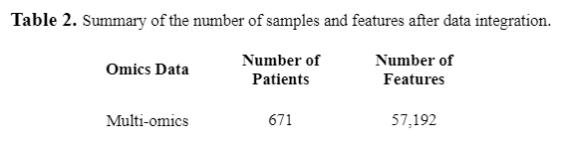
Methodology
Omics Dataset
Data Integration

Slide 11
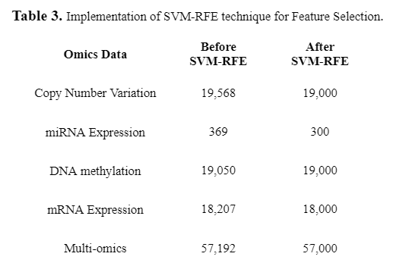
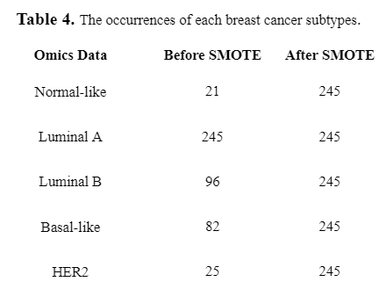
Methodology
Feature Selection
Imbalance Data Handling

Slide 12
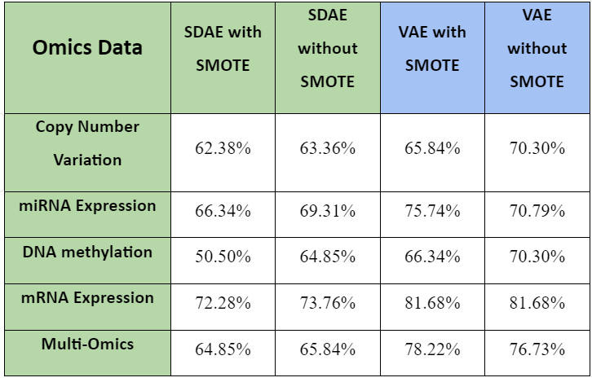
Comparison of accuracy (%) for SDAE and VAE with and without SMOTE on Omics Data
VAE model is perform better than SDAE model, either using SMOTE or without SMOTE in classifying the omics data of breast cancer, the VAE model has a higher mean accuracy value (6.54% and 14.29% with SMOTE) than the SDAE model.
SMOTE method generally does not improve the accuracy results, For the SDAE model, all the accuracy values decrease with a mean accuracy value of 4.75% after applying the SMOTE method.
Both models outperformed when using the single omics data, mRNA expression in classifying breast cancer, SDAE with accuracy of 73.76% and 72.28% with SMOTE; VAE with accuracy value of 81.68% for SMOTE and without SMOTE.

Slide 13
Conclusion
VAE model is more suitable than the SDAE model to classify breast cancer as the accuracy value obtained by VAE is higher than SDAE.
Generally, SMOTE does not help to improve the accuracy value, this may be due to synthetic features generated by SMOTE consisting of noise.
From the results, mRNA expression is the most suitable data for the classification of breast cancer for both SDAE and VAE models, compared to other single omics data, even the multi-omics data.

Slide 14
Achievement
Breast cancer has been classified successfully based on various of omics data using the SDAE and VAE models, where the mRNA expression data achieved the best result of classification.
The performance of the SDAE model and VAE model have been analyzed, where the VAE model achieved better performance than SDAE model.
The classification accuracy obtained from the SDAE model and VAE model using various of omics data has been evaluated, where the classification accuracy obtained from VAE model in mRNA expression data has the highest value, which is 81.68%.

Slide 15
Future Improvement
Identify other combinations of omics data for classification.
Identify the integration method for multi-omics other than concatenation based methods.
Identify other feature selection techniques other than SVM-RFE.

Slide 16


THANK YOU
utmofficial
univteknologimalaysia
utm.my

